Slide 1







Day 3
Networking and Package Management

Slide 2



agenda
Package Management
Networking commands
Archiving and File Transfer (FTP, scp, rsync)
SSH Architecture, Flows and Administering Remote Machines
Interfaces Management and Network Routing
Firewall Management

Slide 3






Package manager
Helps you install, update, configure, and remove software on your system. Instead of manually downloading and compiling programs, the package manager automatically fetches them from trusted repositories, installs required dependencies, and keeps everything up to date.
Package Management
package managers
widely used
dpgk
apt
aptitude
low level package manager
high level package manager
high level package manager
Method of installing, updating, configuring, and removing software on the system in a controlled way
Need to specify the deb file to install
specify only the package name, it will fetch automatically
snap
dependency issues
resolve dependency by automatically fetching the required packages

Slide 4


apt...
What happens under the hood??
There will be lot of repository available
Can edit the sources to get packages from custom repositories if needed
default sources are specified from the parrot repo
apt
apt update
apt install
commands
Repository
apt install <package-name>
apt edit-sources
apt update
apt list
apt remove
apt upgrade

Slide 5







Networking
Can send emails,even download YouTube videos
commands
wget for “offline Google”
client url
curl
To interact with API (GET, POST, and more)
Used to transfer data to or from a server using a variety of protocols such as HTTP, HTTPS, FTP, SCP and more
To get the content of the webpage
wget
To download files from the internet/web
You can stop a download halfway, and resume it later without starting over
With the right flags, wget can mirror an entire website, including all linked pages, images, and assets
web get
REST APIs before tools like Postman existed.
curl is in space 🚀

Slide 6


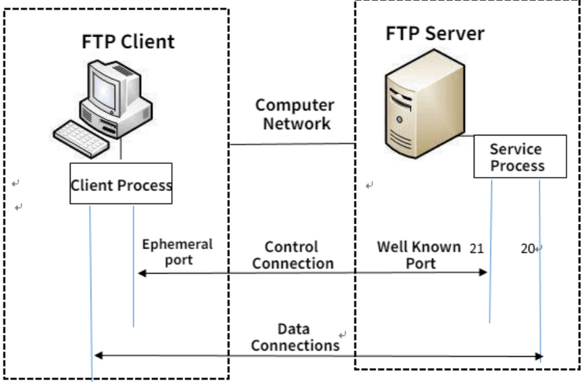



Archiving and File Transfer
rsync (Remote Sync)
FTP (File Transfer Protocol)
Transfer files from one place to another
rsync dir1 dir2 (dir* can be local dir or can be NFS mounted system)
One directional utility and not for syncing the files between two directories
Use SSH by default
When a file is updated at the source and pushed again, the existing data at the destination is not overwritten; instead, a new copy of the file is created at the destination
By default, the meta between the source and target will not be the same
Used to transfer files between a client and a server over a network
Client-server model
TCP port (20, 21)
Have active and passive modes

Slide 7
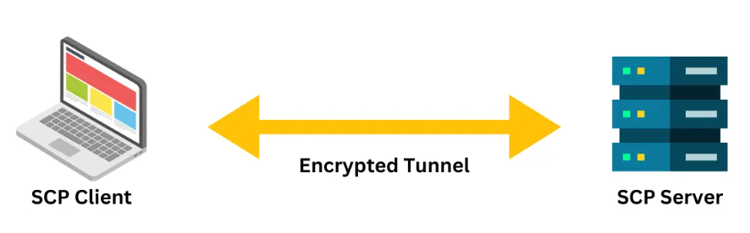
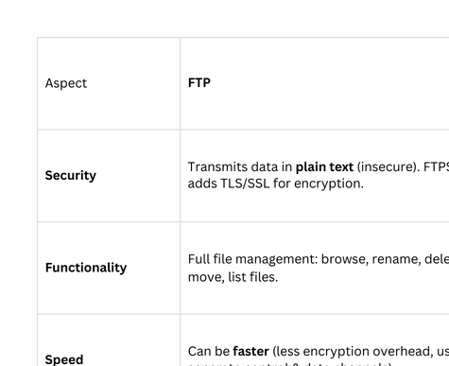
Archiving and File Transfer
SCP (Secure Copy Protocol )
Transfer files securely between Linux/Unix systems over SSH (port 22)
It encrypts Authentication, commands and content

Slide 8


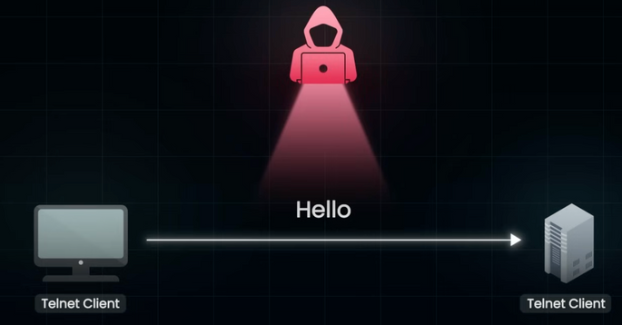




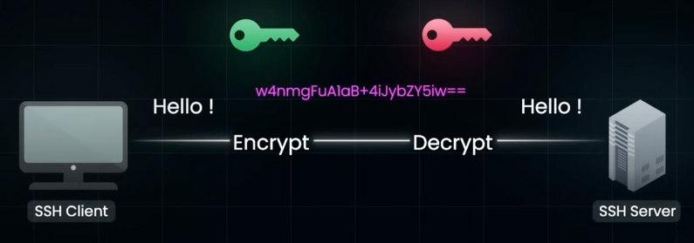
ssh protocol
telnet
secure shell
Atfirst initiates the TCP connection
Create a secure tunnel
Package the data
Encrypt the data
Send to the client
Client decrypts that and use that data
message
message
SSH tunnel
Cryptography
ssh client
ssh server
Symmetric
Encryption
Asymmetric
Encryption

Slide 9


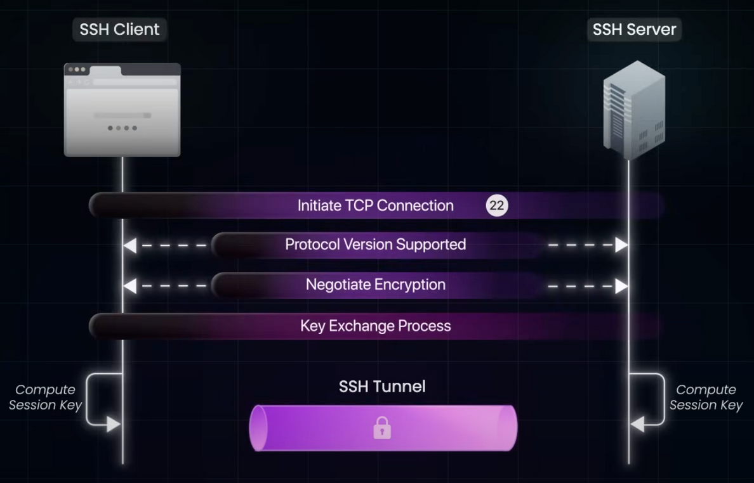
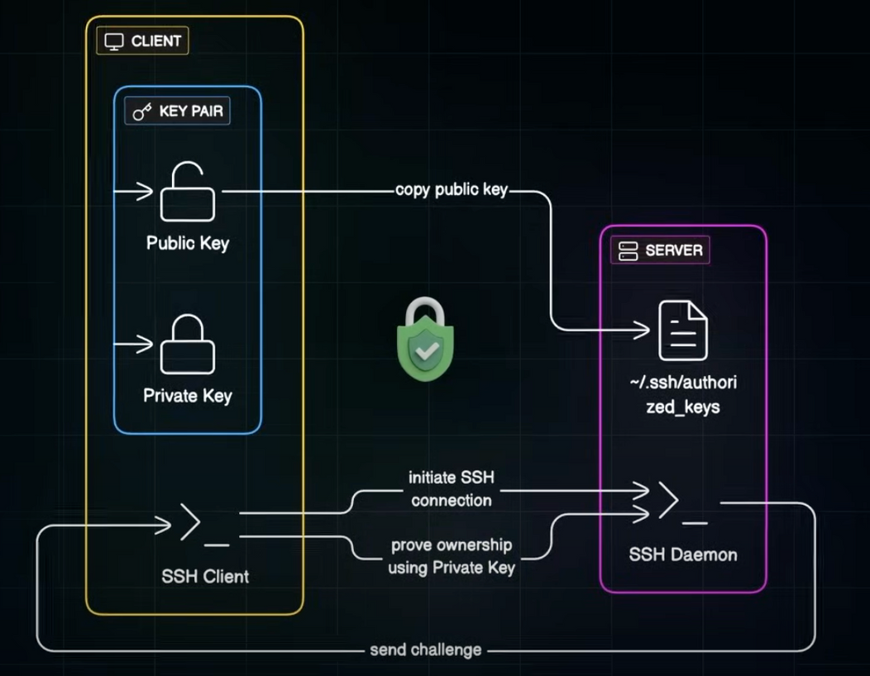
SSH Connection Flow
Key based Authentication

Slide 10

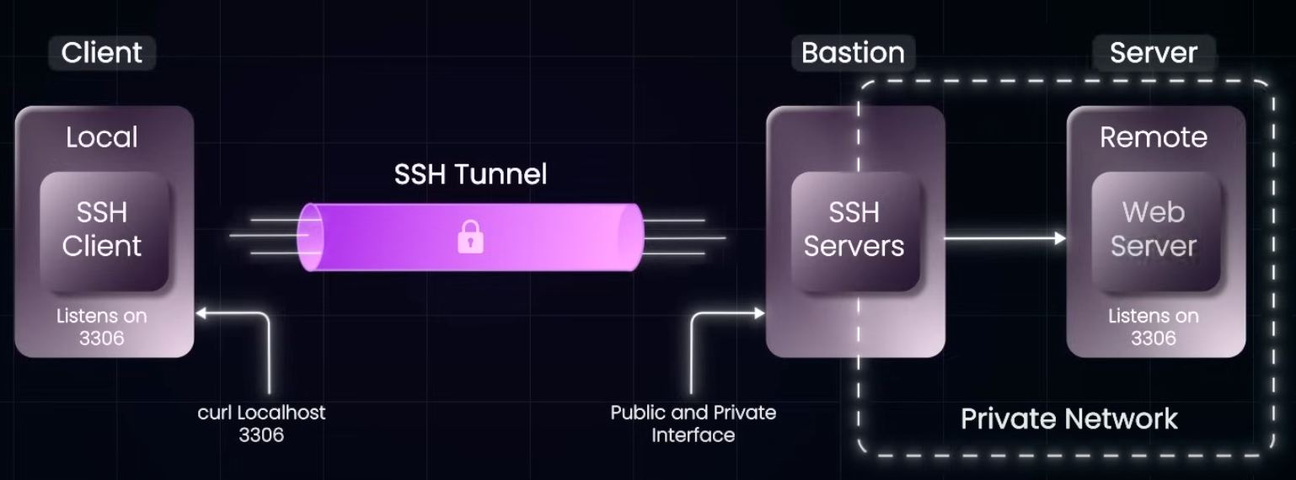


Local forwarding
Establish a secure SSH session to the Bastion host, which provides controlled access to private network instances that are otherwise inaccessible externally

Slide 11


Network interfaces and routing
Network interface:
A door through which your system communicates with the outside world.
Can be physical or virtual endpoint
Each interface has name, hardware id, software id and status
Routes:
Route tells the system where to send the traffic it received
It holds all the routes in the route table
ip route
ifconfig
ip route add <network>/<prefix> via <gateway-ip> dev <interface>
ip link show

Slide 12
Commands
Ping
Checks connectivity between your machine and a remote host by sending ICMP echo requests.
telnet
Tests connectivity to a host on a specific port
telnet <hostname or IP> <port>
route -n
Displays the kernel’s IP routing table.
-n flag shows numerical addresses instead of resolving hostnames (faster).
dig
dig (Domain Information Groper) queries DNS servers to get information about domain names (IP resolution, mail servers, etc.)
dig <domain>

Slide 13







Firewall Management
UFW
Security guard for your server
Checks every packet of data coming in (ingress) or going out (egress) of your system
Based on rules we set, it decides whether to allow or block that packet
Configure the rules properly
Control who and what can access the servers
Why ?
incoming request
outgoing request
Security & compliance
Traffic filtering
Service control
ufw allow|deny from <source_ip> to <dest_ip> port <port> proto <protocol>
ufw allow/deny <port>
ufw enable
ufw status

